Slide 1

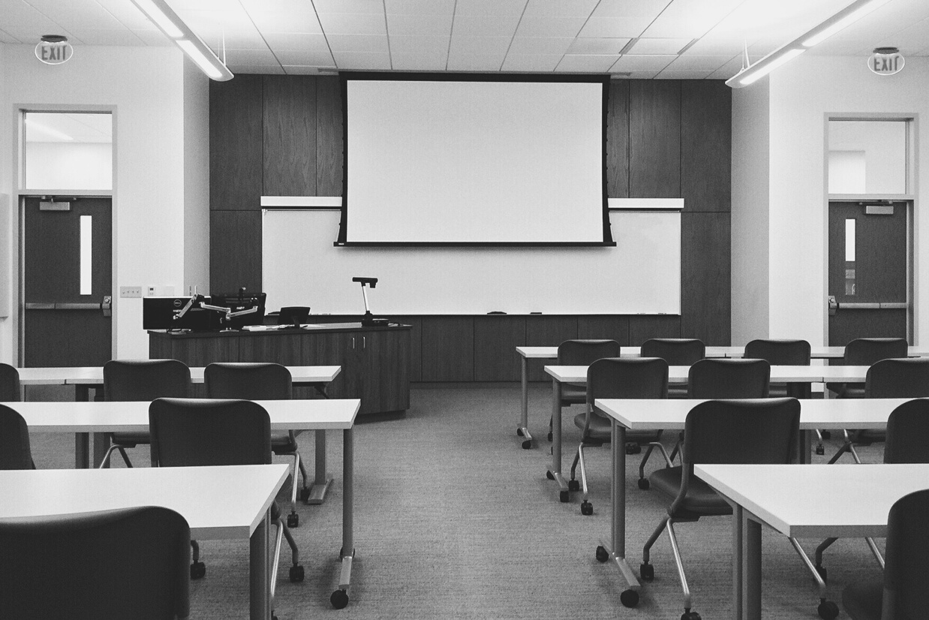



Adult Education Semester A 2020
Kaiako: Sheryl Waru | Tauira: Benita Simati-Kumar
TEACHER:
BENITA SIMATI-KUMAR
FONOFALE TIVAEVAE
TALANOA
TEU LE VA
2020
AKO STRATEGIES
Notes:
This presentation will analyse and identify four ako strategies in my teaching, three of which are communication strategies that are used to contribute to more effective relationships and ako experiences. These strategies have been framed within an Pasifika indigenous lens that draw upon Pacific research models and frameworks critical to Pasifika ways of knowing.

Slide 2




Adult Education Semester A 2020
Kaiako: Sheryl Waru| Tauira: Benita Simati-Kumar
AKO STRATEGY 1
SETTING THE TONE FOR YOUR CLASS:
FONOFALE
Example
For the beginning of each session, it is important for me as a Pacific educator to acknowledge the spiritual wellbeing of my learners; irrespective of their race, religion or cultural background a prayer (lotu or karakia) is effective.
Notes:
Ako Strategy 1: Setting the tone for your class: which draws upon the Fonofale model
For the beginning of each session, it is important for me as a Pacific educator to acknowledge the spiritual wellbeing of my learners; irrespective of their race, religion or cultural background a prayer (lotu or karakia) is effective; as it acknowledges an existence that protects and nurtures every individual in the classroom. Upon reflection, it demonstrates a holistic pedagogy that is based on one of the four pou in the fonofale model. This fonofale model is a commonly used Pasifika model of health that draws on key parts of the Samoan fale to represent holistic Pasifika values and beliefs. The base foundation represents ‘aiga / family; the roof represents culture; the four pou / posts represent spiritual, physical, mental and other (age, gender etc) dimensions (Ministry of Education, 2018). The lotu is effective as it sets the tone for the class, it adheres to the spiritual component of the fonofale model and considers part of the learner’s holistic needs.

Slide 3


Adult Education Semester A 2020
Kaiako: Sheryl Waru | Tauira: Benita Simati-Kumar
AKO STRATEGY 2 GROUP ACTIVITIES:
TIVAEVAE
Example
Group activities foster and encourage positive relationships within small intimate groups, that are practical, communicative, interactive and non-discriminatory.
COMMUNICATION SKILL
Notes:
Ako Strategy 2: Group activities: Tivaevae (communication skill)
Group activities foster and encourage positive relationships within small intimate groups, that are practical, communicative, interactive and non-discriminatory. It draws upon each learners strengths and highlights areas that are challenging, where the group must work together to achieve. This ako strategy adheres to the Tivaevae model from the Cook Islands culture. The model offers a framework for learner collaboration where each member is assigned a task. The quality of the completed tivaevae, reflects on the combined group efforts that demonstrate the strength of relationships and communication. The model can be linked to the following key values: tā’okotai (collaboration), tu‘akangāteitei (respect), ‘uri’uri kite (reciprocity), tu inangaro (relationships) and ‘akairi kite (shared vision) (Ministry of Education, 2018).

Slide 4
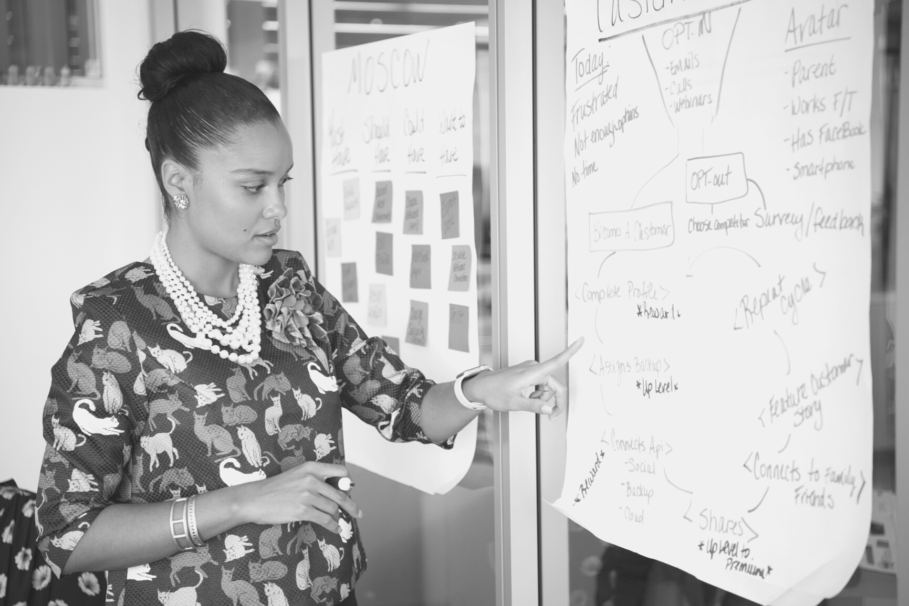
Adult Education Semester A 2020
Kaiako: Sheryl Waru | Tauira: Benita Simati-Kumar
AKO STRATEGY 3
STUDENT PRESENTATION & FEEDBACK:
Example
COMMUNICATION SKILL
When learners are given the opportunity to present they are tasked with the skill of speaking, however, when this is paired with the feedback they are also
encouraged to listen with intent.
TALANOA
Notes:
Ako Strategy 3: Student presentation and feedback: Talanoa (communication skill)
When learners are given the opportunity to present they are tasked with the skill of speaking, however, when this is paired with the feedback they are also encouraged to listen with intent. As frighting as this may be for most learners this ako strategy helps stimulates the curiosity of the learner. This communication can draw upon the leaners lived experiences and challenges them to use and apply what they know in a new context. This ako strategy is known in the Pacific as Talanoa. Tala means to inform or tell, as well as to ask or apply, Noa can mean nothing in particular. Talanoa is a research framework can occur in different forms from informing to interviewing, critical discussion and evaluation (Ministry of Education, 2018). Talanoa is important because it can form a community within the classroom; that fosters and demonstrates learning through conversation and builds relationships where all contributions are valued.

Slide 5



Adult Education Semester A 2020
Kaiako: Sheryl Waru | Tauira: Benita Simati-Kumar
AKO STRATEGY 4 ONE TO ONE:
TEU LE VA
COMMUNICATION SKILL
Example
One to one sessions as the educator in the teaching space is what I try to achieve as an ako strategy to ensure learner needs are planned for and met.
References
Ministry of Education. (2018). Tapasā: Cultural competencies framework for teachers of Pacific learners. Ministry of Education New Zealand Te Tāhuhu o te Mātauranga. https://pasifika.tki.org.nz/Tapasa
Notes:
Ako Strategy 4: One to one: Teu e Vā
One to one sessions as the educator in the teaching space is what I try to achieve as an ako strategy to ensure learner needs are planned for and met. Even in a short conversation with each learner, it is important for me to acknowledge their presence in the class and encourage their learning. This ako strategy refers to the Pacific concept of Teu le vā, this translates to nurturing the space between; this acknowledges the importance of relationships for understanding and communication between the educator and learner. As a learning space, the learners need to feel valued and respected for them to open up and share. Building trust and feeling safe for the learner's wellbeing is essential to the concept of Teu le vā; as we need to understand our place in relation to others. One to one sessions allows both educator and learner to communicate and connect through similarities and differences. Teu le va nurture, sustain and maintains a connection with the learner if there is healthy communication.

